Slide 1
EECS 498 System Design of a Search Engine
Winter 2026
Lecture 17: Ranking
Nicole Hamilton
https://web.eecs.umich.edu/~nham/
nham@umich.edu

Slide 2
agenda
details
ranking

Slide 3
agenda
details
ranking

Slide 4
details
Please read my Dynamic Ranking paper, posted on Canvas.
The Robots.txt assignment is posted.
It’s more “paint by numbers” than I’d like but I’m late giving it to you and I’d like to keep the work reasonable. (If they let me teach this again, I may make it harder the next time.)
If you’ve already started your own design, I’m hopeful my interface is generic enough you can work with it.
I’m almost finished writing the AG tests. It’ll test functionality, memory leaks, and performance.

Slide 5
class RobotsTxt
{
public:
// Constructor to parse the robots.txt file contents into a
// set of rules.
RobotsTxt( const Utf8 *robotsTxt, const size_t length );
// Destructor
~RobotsTxt( );
// Check a full URL against the rules in this robots.txt.
// Return true if access is allowed. Optionally report
// any crawl delay.
bool UrlAllowed( const Utf8 *user, const Utf8 *url,
int *crawlDelay = nullptr );
// Check the path portion of a URL against the rules in this
// robots.txt. Return true if user is allowed to crawl the path.
// Optionally report any crawl delay.
bool PathAllowed( const Utf8 *user, const Utf8 *path,
int *crawlDelay = nullptr );
// Get the list of paths specified in any Sitemap statements.
std::vector< std::string > Sitemap( );
};

Slide 6

tee shirts
We are very close to announcing the tee shirt.
It’s now a yellow octopus on a faded cream color shirt.
You’ll order and pay online but then they’ll print and ship them at once

Slide 7
agenda
details
ranking

Slide 8
the problem
For any given query, matching pages likely fall into a pyramidal distribution.
A small number of really good ones.
More that are of middling quality, and
An enormous number that are terrible.

Slide 9
ranking
Objective is to order pages the same way a human would do using software.
Do a calculation based on what's known about:
All the documents and words in the index.
A matching page.
Match between the query and the page.

Slide 10
ranking
This has to be done without knowing:
  How many other pages match,
  What they look like,
  Or even if they exist.
It must also be reasonably consistent across individual nodes to allow the results from different nodes to be compared and merged.

Slide 11
ranking
The rank value should obey the desired ordering relationship, that a better page will get a better score.
Since search engines typically broadcast a query to a large number of machines with differing fractions of the web and then combine the results, the calculation should be consistent even though the samples might be a little different.
Beyond ordering, the value is otherwise meaningless: If page A's rank is twice that of page B, it does not mean that A is twice as good as B.

Slide 12
Only two ways to get better at ranking:
Have more or better information.
Make better use of it.

Slide 13
static vs. dynamic rank
Static Quality of the page independent of the query, e.g., PageRank, length of the URL, title or page, domain (.gov or .edu vs. .biz), whether it contains images, pornographic content, etc.
Dynamic Quality of a page as possible result for a specific query considering both static rank and the quality of the match between the query and the page.

Slide 14
static rank
Some pages are just better than others before you know anything about the query.

Slide 15
Static rank
Some domains are better than others, e.g., .gov or .edu over .biz.
Short URLs are better.
Short titles are probably better.
Some pages may be obvious spam.
Some pages may have lots of other pages pointing to them.

Slide 16
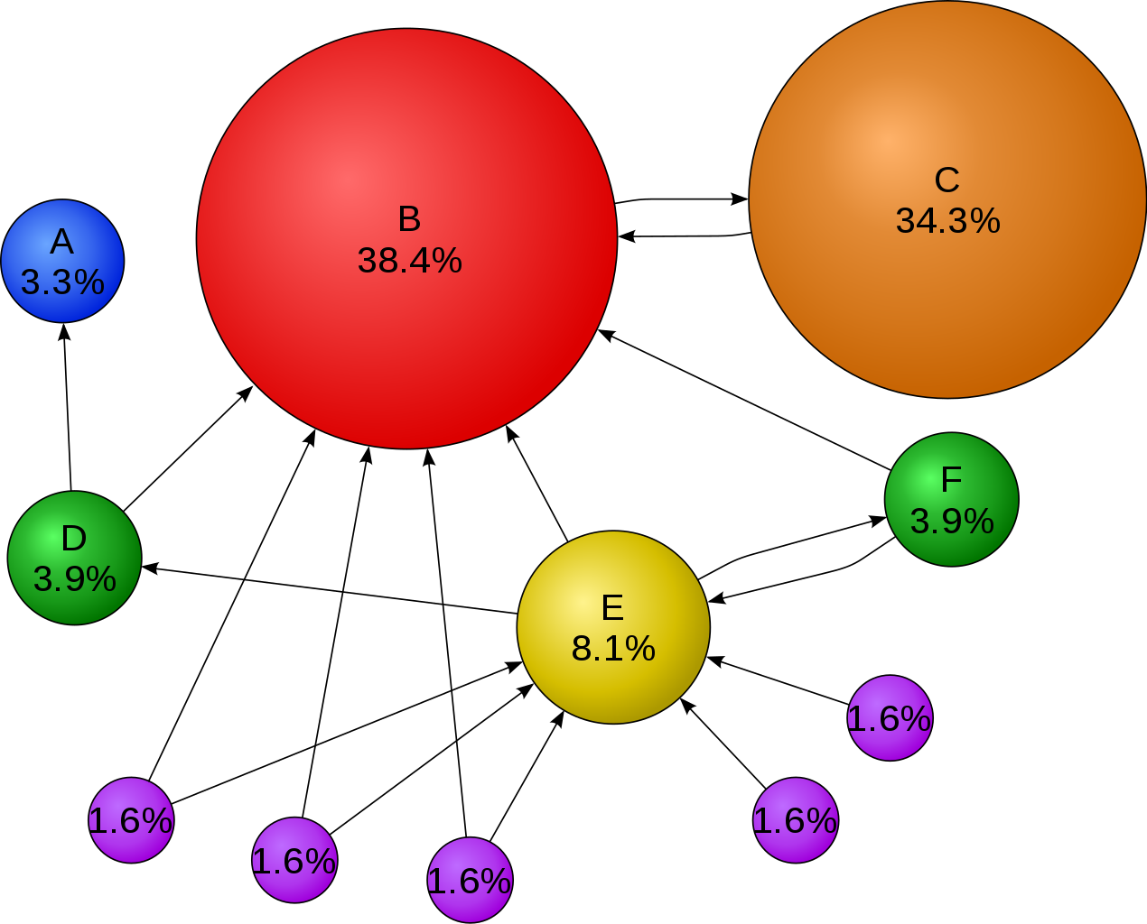
PageRank
A detour into the world’s most famous link-analysis algorithm.
The basic idea: The more and better links to a page, the more likely it should rank higher.
Image source: https://upload.wikimedia.org/wikipedia/commons/thumb/f/fb/PageRanks-Example.svg/1270px-PageRanks-Example.svg.png

Slide 17
PageRank random surfer
The model was that people surfed the web, somewhat randomly either clicking on one of the links on the page or going somewhere else.
If an important page pointed to yours, some of that importance should bleed onto yours.

Slide 18
basic PR algorithm
PR output is a vector of probabilities that a person randomly clicking links will arrive at a particular page.
Initially all probabilities usually assumed equal (or maybe not!)
Links from a page to itself are ignored.
Multiple links from one page to another are treated as a single link.
The PR transferred from one page to another is its PR divided by number of pages it links to.
At each iteration, the new PR of a given page is calculated as the sum of the PRs transferred to it.
Repeat until it settles.

Slide 19
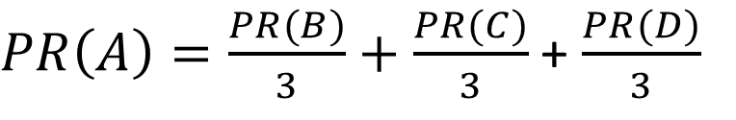
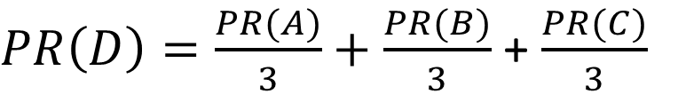
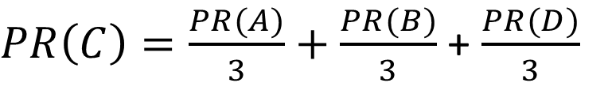
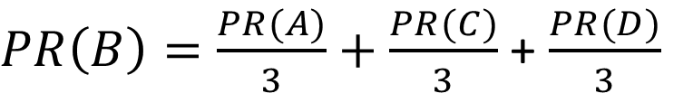
$PR\left(A\right)=\frac{PR(B)}{3}+\frac{PR(C)}{3}$ + $\frac{PR(D)}{3}$
A
B
$PR\left(B\right)=\frac{PR(A)}{3}+\frac{PR(C)}{3}$ + $\frac{PR(D)}{3}$
$PR\left(C\right)=\frac{PR(A)}{3}+\frac{PR(B)}{3}$ + $\frac{PR(D)}{3}$
C
D
$PR\left(D\right)=\frac{PR(A)}{3}+\frac{PR(B)}{3}$ + $\frac{PR(C)}{3}$

Slide 20
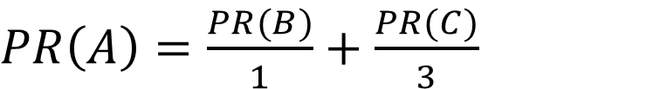
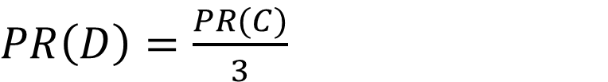
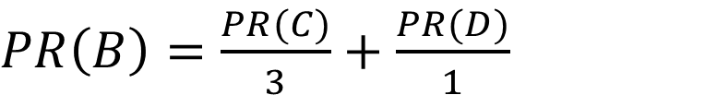
$PR\left(A\right)=\frac{PR(B)}{1}+\frac{PR(C)}{3}$
A
B
$PR\left(B\right)=\frac{PR(C)}{3}+\frac{PR(D)}{1}$
$$PR\left(C\right)=0$$
C
D
$PR\left(D\right)=\frac{PR(C)}{3}$

Slide 21
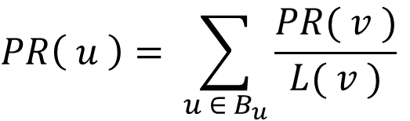
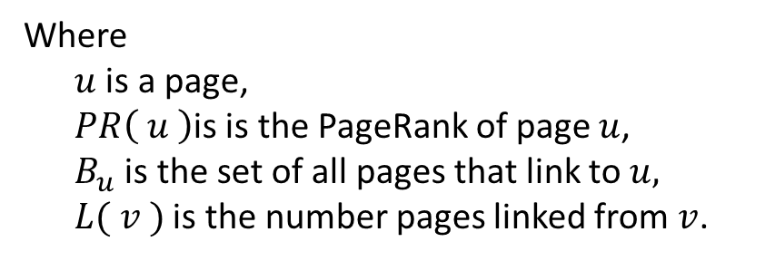
$$PR\left( u \right)= \sum_{u ∈ B_{u}}{\frac{PR( v )}{L( v )}}$$
A
B
Where
$u$ is a page,
$PR\left( u \right)$is is the PageRank of page $u$,
$B_{u}$ is the set of all pages that link to $u,$
$L( v )$ is the number pages linked from $v$.
C
D

Slide 22
damping factor
But in this basic version, PR sinks could happen, where at every iteration, a site just got more and rank.
They solved this by adding the notion that their imaginary surfer randomly clicking links will eventually stop clicking and simply start over at some other random page. This became a damping factor in PageRank.

Slide 23
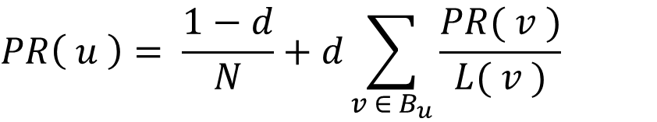
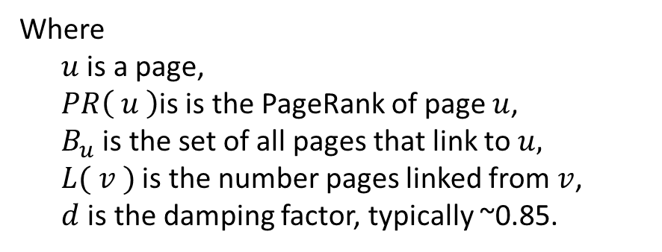
$$PR\left( u \right)= \frac{1−d}{N}+d\sum_{v ∈ B_{u}}{\frac{PR( v )}{L( v )}}$$
A
B
Where
$u$ is a page,
$PR\left( u \right)$is is the PageRank of page $u$,
$B_{u}$ is the set of all pages that link to $u,$
$L( v )$ is the number pages linked from $v$,
$d$ is the damping factor, typically ~0.85.
C
D

Slide 24
PageRank
It obviously did work and Google got better results.
It also gave halo of special legitimacy to their results, that they were scientific and unbiased.

Slide 25
at Microsoft
We gamely expected our version of PageRank to represent about half the overall rank value, largely based on the hype around it.
Turned out it was very expensive to calculate and represented only a small part of the final rank score.
Mark Najork of Mercator fame argued for lumping whole domains together in something called DomainRank. But it hadn’t yet worked when I left.

Slide 26
Ranking process
Compile the query.
Search the index for matching pages.
Return a list of the n best with scores indicating estimated quality.
May also return debug information to allow the scoring calculation to be examined.

Slide 27
Question
How should you find the n best?
Should you get the entire list and then sort?

Slide 28
question
How should you find the n best?
Should you get the entire list and then sort?
No, you should probably insertion sort into array of n elements.

Slide 29
decorating
Add characters that get stripped out during HTML parsing to indicate special characteristics or types of posts, e.g.,
amazon amazon in the body text
#amazon amazon only in the URL
@amazon amazon only in the title
$amazon amazon only in the anchor text
% End-of-document token.
Might also be used for stemming:
swim* swim, swims, swimming, etc.

Slide 30
decorating vs. attributes
Use decorating when you’d like to use it for searching, to shrink the size of a post or because you’d like to separate the scoring for hits in the title vs. the body for example.
Use attributes when the ranker will want the information about each post and it could be different every time.

Slide 31
Matches in order of importance:
Anchor text.
URL.
Title.
Body.
Exception is Japan where URL matches are less useful due to mismatch between Kanji or Katakana queries and transliterated URLs.
URLs may need dictionary word-breaking or regex-style matching to be useful. Again, beyond the scope.

Slide 32
Does it matter how many ISRs you use?
How much effect will this have on query search time?
What dominates search time?

Slide 33
basic ranking
Matching pages found by the constraint solver but that only finds the page and the static information about the page from the enddoc.
Queries are flattened. (Very hard to estimate the probability of phrases or other combinations of OR’ing and AND’ing terms.)
ISRs are reset to the beginning of the document, then advanced through the page, extracting data about where the search words were found.
Three strategies from there.

Slide 34
queries are flattened
These queries all match different sets of pages:
apollo moon landing
( apollo | moon ) landing
“apollo moon landing”
But for scoring, they’re all flattened to the same list of search words.

Slide 35
three strategies
Bag of words: The more hits the better.
Heuristics: Look for exact matches, matches in the right places, hand or machine-tuned.
Machine learning, typically with a neural net.

Slide 36
bag of words
Count the number of matches of each of the search words, typically weighted by the frequency of the word within the corpus.
Two most famous:
tf-idf
BM25

Slide 37
tf-idf
Term-frequency, inverse document frequency.
Bag of words technique. The more occurrences of a rare word, the better.
Combined:
Term weighting based on frequency invented by to Hans Peter Luhn in 1957.
Statistical interpretation invented by Karen Spärck Jones in 1972.

Slide 38
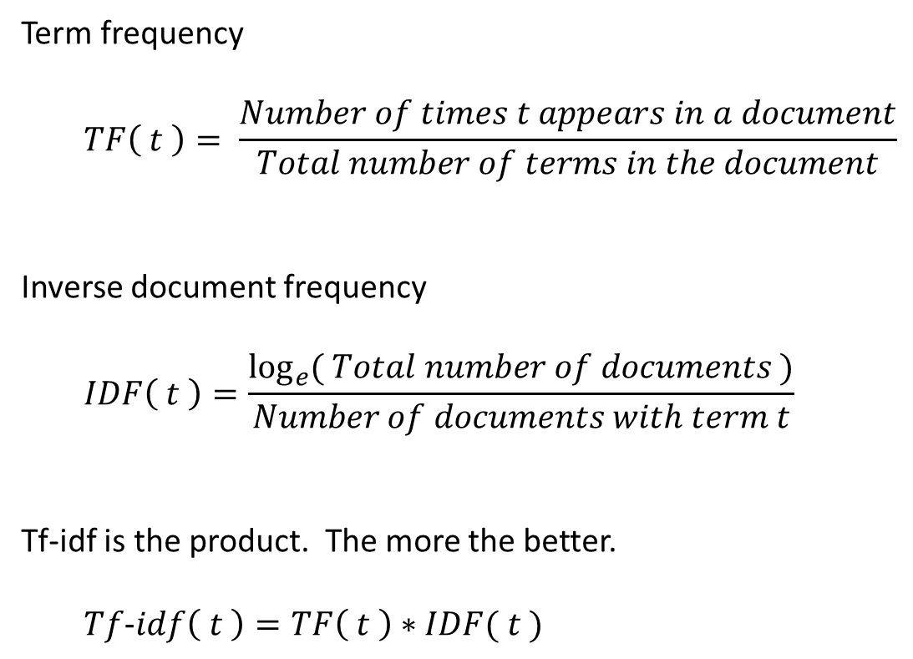
Term frequency
  $$TF\left( t \right)= \frac{Number of times t appears in a document}{Total number of terms in the document}$$
Inverse document frequency
  $$IDF\left( t \right)=\frac{\log_{e}{( Total number of documents )}}{Number of documents with term t}$$
Tf-idf is the product. The more the better.
  $$Tf−idf\left( t \right)=TF\left( t \right)∗IDF( t )$$

Slide 39
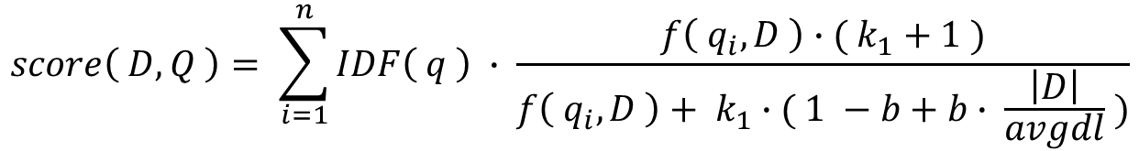


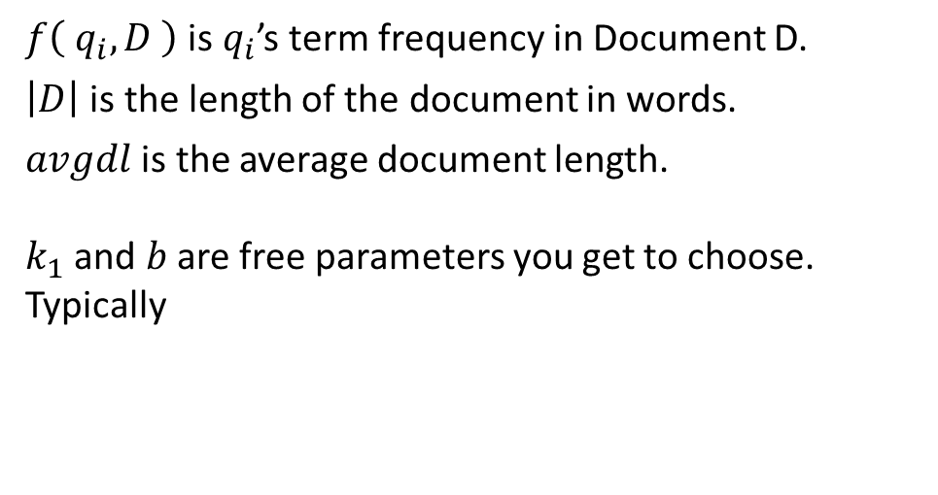
Okapi BM25
Okapi Best Matching function, a similar bag of words technique.
$$score\left( D, Q \right)= \sum_{i=1}^{n}{IDF\left( q \right) ∙ \frac{f\left( q_{i}, D \right)∙( k_{1}+1 )}{f\left( q_{i}, D \right)+ k_{1}∙( 1 −b+b∙ \frac{\left|D\right|}{avgdl} )}}$$
$f\left( q_{i}, D \right)$ is $q_{i}$’s term frequency in Document D.
$\left|D\right|$ is the length of the document in words.
$avgdl$ is the average document length.
$k_{1}$ and $b$ are free parameters you get to choose.
Typically
$$k_{1}∈ \left[ 1.2, 2.0 \right]$$
$b$ = 0.75

Slide 40
bag of words
Problem is, bag of words techniques simply don’t work very well on the web because they don’t do well at distinguishing quality, especially, to find the best match.
They simply cannot distinguish that a page with all the search words in the right order, as an exact phrase, or near the top of the page is better than a page where the words are randomly scattered.
It’s also susceptible to keyword spamming.

Slide 41
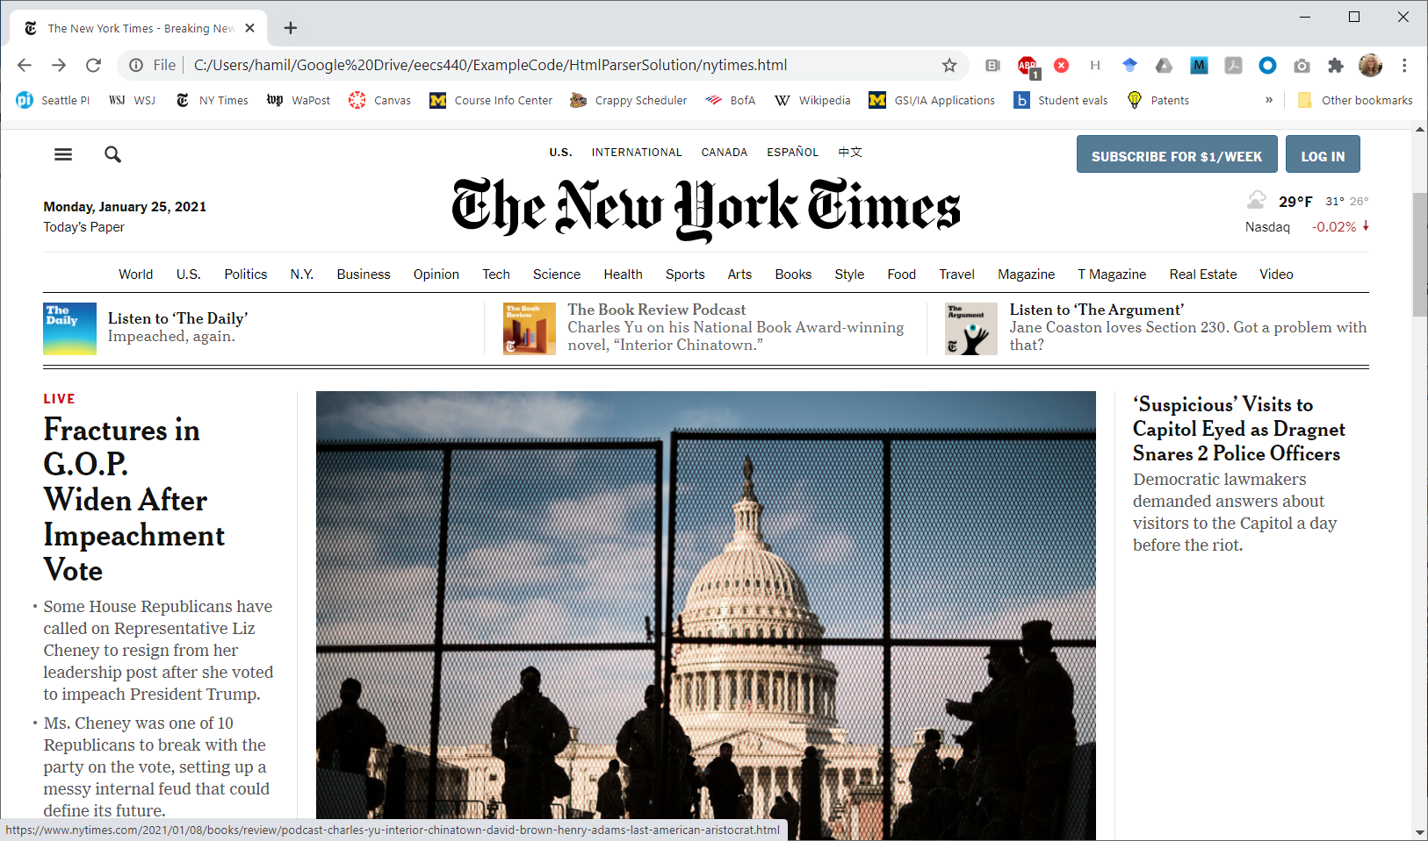
bag of words
Here’s a sample NY Times page from Jan 25, 2021.

Slide 42
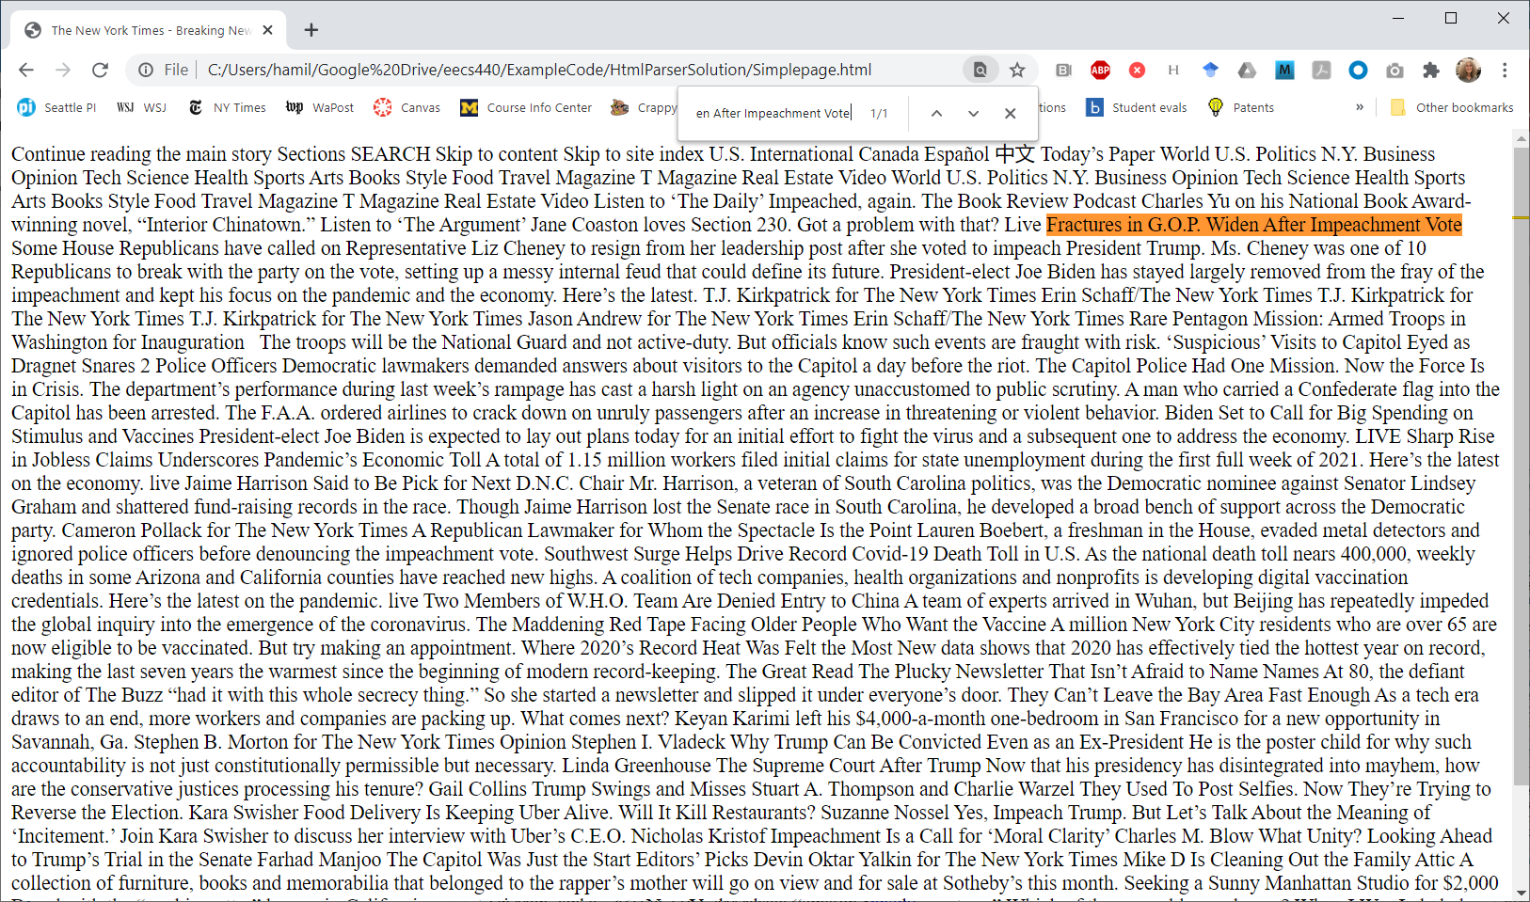
bag of words
Here it is stripped of HTML and CSS but the text remains.

Slide 43
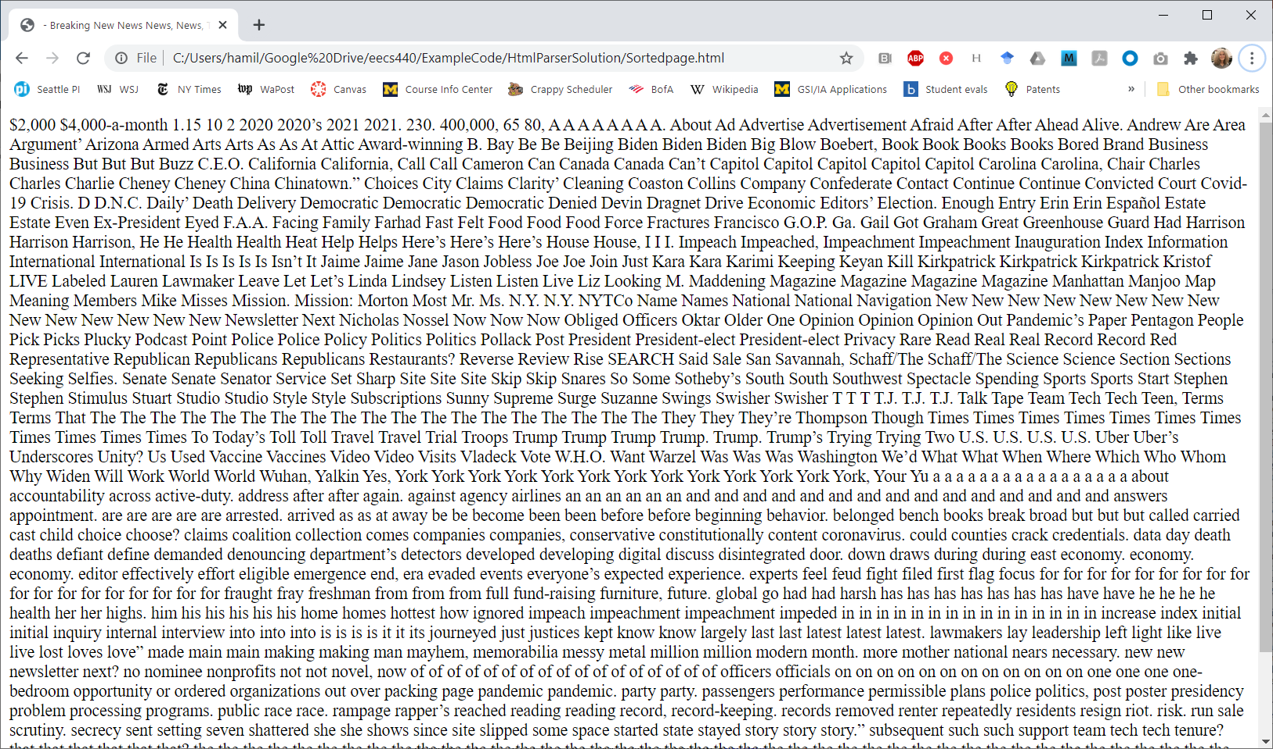
bag of words
Here it is with the words in the title and body sorted. Tf-idf can’t tell the difference.

Slide 44
heuristics
Incrementing a flurry of low-level counters, e.g., number of times each word occurred, number of times an exact phrase matching the query was found.
Large number of cheap heuristics that are expected to provide evidence of the quality of the match.

Slide 45
query processing
Compile the query into a structure of ISRs.
Pass the ISRs to the constraint solver to find matching pages.
For each matching page:
  Move the ISRs back to the beginning of the page and scan for hits.
  Calculate a rank value and insertion sort the page into a list of n best.

Slide 46
Example phrase query "quick brown fox“ and their 3 posting lists.
Individual search words appear individually many times but there are only two exact phrases. The constraint solver will stop on the first phrase match, then it's up to the ranker to decide what next.
brown
83
94
170
179
216
227
400
417
422
516
795
826
828
957
brown
83
94
170
179
216
227
400
417
422
516
795
826
828
957
quick
62
69
84
311
421
430
559
619
794
952
quick
62
69
84
311
421
430
559
619
794
952
fox
284
423
580
612
796
912
958
fox
284
423
580
612
796
912
958

Slide 47
Example phrase query "quick brown fox".
A suggested first step in ranking is to flatten the query, pulling out all the individual ISRs and seeking them to the beginning of the document.
brown
83
94
170
179
216
227
400
417
422
516
795
826
828
957
quick
62
69
84
311
421
430
559
619
794
952
brown
83
94
170
179
216
227
400
417
422
516
795
826
828
957
fox
284
423
580
612
796
912
958
quick
62
69
84
311
421
430
559
619
794
952
fox
284
423
580
612
796
912
958

Slide 48
Example phrase query "quick brown fox".
From there, you can move the ISRs any way you like to extract data as long as they only go forward.
Word counts:
quick 10
brown 14
fox 7
Two possible strategies:
Simply count the words.
Look for places where the words occur together in interesting ways.
quick
62
69
84
311
421
430
559
619
794
952
brown
83
94
170
179
216
227
400
417
422
516
795
826
828
957
fox
284
423
580
612
796
912
958

Slide 49
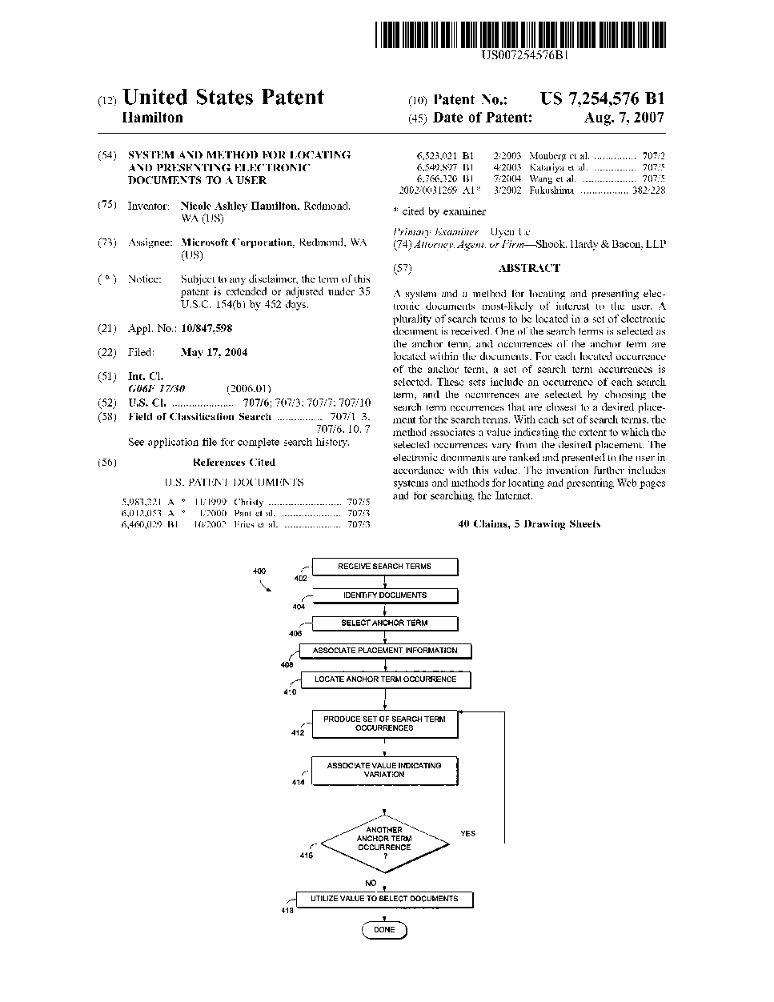
Example phrase query "quick brown fox".
I'm going to show you a simpler strategy I invented at Microsoft.
quick
62
69
84
311
421
430
559
619
794
952
brown
83
94
170
179
216
227
400
417
422
516
795
826
828
957
fox
284
423
580
612
796
912
958

Slide 50
I was very concerned that my ranker would single-handedly blow us out of the water on perf and I wanted something really simple.
It was all integer math and done in a single pass over each page.

Slide 51
AND'ing streams
quick 10 27 105 513 518 520
brown 28 50 62 70 514 790
fox 87 106 515 550 1200
#DocEnd 112 570 1006 1704
quick fox How many possible combinations? 6
Can you reach all of them in a single pass, all ISRs only moving forward? No.
Would prefer a technique that allows the ISRs to be moved only in a single pass.

Slide 52
basic strategy
Choose rarest word as an anchor and advance that ISR through each occurrence in the document.
At each occurrence of the rarest word, advance the other ISRs to position them as close as possible to the desired position in the flattened list.
Requires only one stage of look-ahead.

Slide 53
spans
If there is at least one occurrence of each query term, that’s a “span” which can be further distinguished as ordered, short, an exact phrase, etc.
Only the rarest word is guaranteed to a unique occurrence.
The other words may be reused.
Also count doubles and triples, meaning various combinations of just 2 or 3 of the words in the query, one of which must be the rarest.
Parameterized threshold for short vs. long spans, frequent vs. infrequent, etc.
Most features are binary and either occur or do not occur unambiguously.

Slide 54
Example phrase query "quick brown fox".
What I did was pick the rarest word and then arrange the other ISRs to as close as possible to their desired locations in the query relative to each occurrence of the rarest word.
Word counts:
quick 10
brown 14
fox 7
This reduces the number of combinations to be scored in this example from 10*14*7 = 957 to 7 and can be done a single pass with a single stage of lookahead.
Call each combination a span.
quick
62
69
84
311
421
430
559
619
794
952
brown
83
94
170
179
216
227
400
417
422
516
795
826
828
957
fox
284
423
580
612
796
912
958

Slide 55
Example phrase query "quick brown fox".
Iterate over the rarest word hits, arranging the other ISRs to as close as they could be to their desired locations in the query. Here are the first 3 spans.
brown
83
94
170
179
216
227
400
417
422
516
795
826
828
957
brown
83
94
170
179
216
227
400
417
422
516
795
826
828
957
brown
83
94
170
179
216
227
400
417
422
516
795
826
828
957
quick
62
69
84
311
421
430
559
619
794
952
quick
62
69
84
311
421
430
559
619
794
952
quick
62
69
84
311
421
430
559
619
794
952
fox
284
423
580
612
796
912
958
fox
284
423
580
612
796
912
958
fox
284
423
580
612
796
912
958

Slide 56
Example phrase query "quick brown fox".
For each combination, decide if it's an exact phrase or all the words in order, or close together, incrementing an associated counter. Shown here, there is one exact phrase but none of the rest are in order or particularly close together.
brown
83
94
170
179
216
227
400
417
422
516
795
826
828
957
brown
83
94
170
179
216
227
400
417
422
516
795
826
828
957
brown
83
94
170
179
216
227
400
417
422
516
795
826
828
957
quick
62
69
84
311
421
430
559
619
794
952
quick
62
69
84
311
421
430
559
619
794
952
quick
62
69
84
311
421
430
559
619
794
952
fox
284
423
580
612
796
912
958
fox
284
423
580
612
796
912
958
fox
284
423
580
612
796
912
958

Slide 57
Example phrase query "quick brown fox".
brown
83
94
170
179
216
227
400
417
422
516
795
826
828
957
brown
83
94
170
179
216
227
400
417
422
516
795
826
828
957
quick
62
69
84
311
421
430
559
619
794
952
brown
83
94
170
179
216
227
400
417
422
516
795
826
828
957
quick
62
69
84
311
421
430
559
619
794
952
quick
62
69
84
311
421
430
559
619
794
952
fox
284
423
580
612
796
912
958
fox
284
423
580
612
796
912
958
fox
284
423
580
612
796
912
958

Slide 58
Example phrase query "quick brown fox".
brown
83
94
170
179
216
227
400
417
422
516
795
826
828
957
This last one is close together (say, less than 10 words apart) and in order but it's not an exact phrase.
quick
62
69
84
311
421
430
559
619
794
952
fox
284
423
580
612
796
912
958

Slide 59
Example phrase query "quick brown fox".
brown
83
94
170
179
216
227
400
417
422
516
795
826
828
957
Set some thresholds and accumulate some counts, which can be scored at the end.
Thresholds Values
Max to be short 10
Min to be frequent ?
Min to be most ?
Min to be near the top ?
Heuristic Count Weight Score
Number of short spans 1 5 5
Number of in order spans 1 2 2
Exact phrases 2 10 20
Number of spans near the top ? ? ?
All word are frequent ? ? ?
Most words are frequent ? ? ?
Some words are frequent ? ? ?
Total dynamic rank score ?
quick
62
69
84
311
421
430
559
619
794
952
fox
284
423
580
612
796
912
958

Slide 60
Example phrase query "quick brown fox".
brown
83
94
170
179
216
227
400
417
422
516
795
826
828
957
One reason to decorate words as anchor, URL, title or body is so they can be separated in to separate streams (separate sets of ISRs) and scored separately with the same algorithm but different scoring parameters.
quick
62
69
84
311
421
430
559
619
794
952
Stream Weight Score
Anchor ? ?
URL ? ?
Title ? ?
Body ? ?
Total dynamic rank score ?
fox
284
423
580
612
796
912
958
Each of the streams can start at location 1 relative to the start of the document. The document length is the length of the longest stream.
Not all streams may contain all the words.

Slide 61
Example phrase query "quick brown fox".
brown
83
94
170
179
216
227
400
417
422
516
795
826
828
957
We do a similar heuristic calculation of the static rank, the quality of the page independent of the query.
Heuristic Weight Score
Short title ? ?
Nice document length ? ?
Short URL ? ?
Lots of anchor text ? ?
edu/gov/com/etc domain ? ?
PageRank if known ? ?
Total static rank score ?
quick
62
69
84
311
421
430
559
619
794
952
fox
284
423
580
612
796
912
958

Slide 62
Example phrase query "quick brown fox".
brown
83
94
170
179
216
227
400
417
422
516
795
826
828
957
Combine static and dynamic rank to get a final score.
Component Weight Score
Static rank ? ?
Dynamic rank ? ?
Total rank score ?
quick
62
69
84
311
421
430
559
619
794
952
fox
284
423
580
612
796
912
958
The result is a linear combination of features. We're just adding them up.
You should be able to achieve reasonably good results with a reasonably small number of heuristics and simple hand-tuning starting from some rough guesses at, e.g., the relative importance of an exact phrase versus lots of individual hits.

Slide 63
The actual score is calculated as a linear combination of features, which may be thought of as:
R = Σ Ci( Q ) * Ai( P, Fi ) * Si( Fi )
Where:
R = Overall Rank
Q = The Query and its characteristics, e.g., the number of rare vs. common words in the query.
P = The Page and its characteristics, e.g., the number of words in the URL or title.
Fi = An arbitrary feature observation, e.g., an exact phrase in the title, or a raw value, e.g., raw PageRank.
Si = Scaling for feature Fi from the raw number space of the feature into a nominal 0.0 .. 1.0 range.
Ai = Attribute scaling for feature Fi, possibly dependent on the characteristics of the page P.
Ci = Coefficient for feature Fi, depending on the characteristics of the query Q.
Fi = Ei( Q, P, T )

Slide 64
steps to ranking
Decide what information to collect and how to measure it.
Decide how to measure the quality of the result.
Pick a method for scoring a page based on the inputs.
Tune the system by testing it on sample queries and adjusting parameters, collecting more information or changing the scoring algorithm.

Slide 65
measuring quality
At Microsoft, initially, I just ran queries and eyeballed the results and fiddled with the parameters.
Results were surprisingly good.

Slide 66
measuring quality
We were also collecting labeled pages. We scraped queries and results from several engines and then paid people to rate results on a 0 to 5 scale.
5 Definitive result. Unlikely any other page could be a better result for this query, e.g., whitehouse.gov for "whitehouse".
:
0 Completely deleterious result, e.g., porno, spam, phishing.
This is similar to what Google is doing with their Page Quality Rating Guidelines, creating specificity in the ratings.
Altogether, I think we had about 50K queries and about 150K labeled results.

Slide 67
measuring quality
Next came a tool allowing us to do side-by-side comparison of results with current best parameters in a frame on the left and with a set you could tweak on the right.
If the pages had been labeled, it reported the quality and attempted to score the resulting set.
We ran a competition to see who could come up with the best settings.

Slide 68
measuring quality
Finally, we added a tuner that could adjust the parameters mechanically by gradient descent: Tweak an individual parameter rerun all the searches and measure whether the results got better (more highly ranked pages for each query.)
But we had lots of problems in the methodology of what to do with unlabeled pages.

Slide 69
measuring quality
Initially unlabeled pages were assumed to be “average”. Later, a “promising proximity” heuristic was added to the tuner bump the estimate for unlabeled pages if the search words were found close together.
The effect was to tune my complex ranker to behave like the tuner’s naïve ranker.
Better strategy would have been to only tune based on labeled results, discarding any unlabeled results or construct an index that only contained labeled pages.

Slide 70
generating labeled results
You can’t afford to pay people to label results but you might assume that Google is pretty good, so you might simply try to get pages in the same order as Google.
Your ranker won’t be as good as Google’s, so it might not be able to discern the difference between the top results on the first page, but perhaps it could distinguish between results on the first page and results on the tenth page.

Slide 71
strategy
Create a list of popular short queries.
Scrape Google for first 10 pages of results and label them.
Create an index of only those pages.
Make some initial estimates of the weights of your heuristics.
While you’re still making progress:
  Run each query and count how many you got right.
  Iterate over each heuristic, adjusting it up or down a little to see if there’s any improvement.
  Pick the best as a new starting point.

Slide 72
remarks
It is much easier to tune weights for binary features than for those encoding a range of “goodness”.
It is difficult to estimate the improvement you’ll get from a new feature without actually building it. A lot of it is intuition.

Slide 73
remarks
Think about what “blindspot” is created by not having the new proposed features.
When would the ranker not be able to tell the difference between two pages it should be able to distinguish?
How egregious would that be and how often would it occur?
What is your ranker getting wrong right now and would a simple heuristic fix it?
This kind of thinking led us to add features like “exact match” for the title.

Slide 74
remarks
Mechanically tuned parameter weights can be counter-intuitive if some of your heuristics overlap.
You can get a negative weight for something that should be good because it overlaps with something better.

Slide 75
how to do better
To do better than heuristics, you will probably need a neural network.

Slide 76
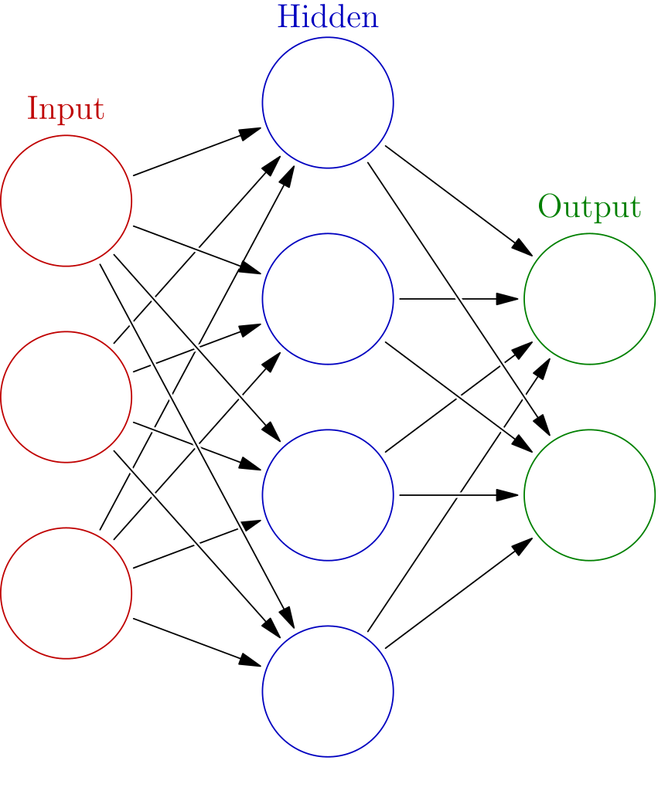
Example phrase query "quick brown fox".
A machine learning strategy would be to simply collect all the lists and pass everything to a neural network, which must be trained. Beyond the scope here.
quick
62
69
84
311
421
430
559
619
794
952
brown
83
94
170
179
216
227
400
417
422
516
795
826
828
957
fox
284
423
580
612
796
912
958
Image source: https://en.wikipedia.org/wiki/Artificial_neural_network

